Slide 1

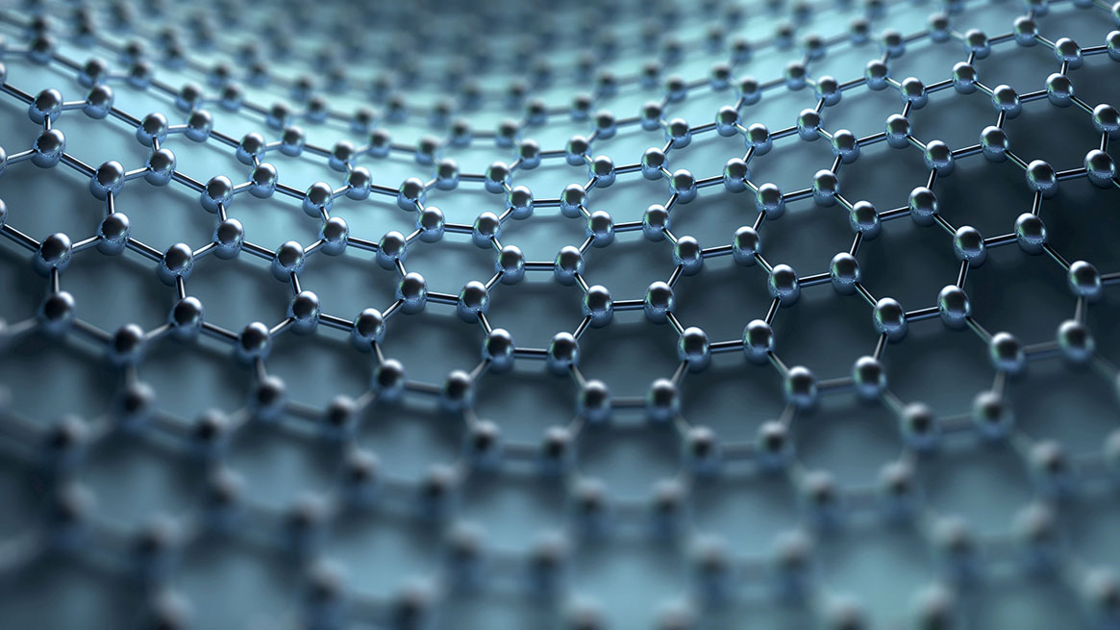
Reinforcement Learning Agent for Splendor
App Showcase

Slide 2
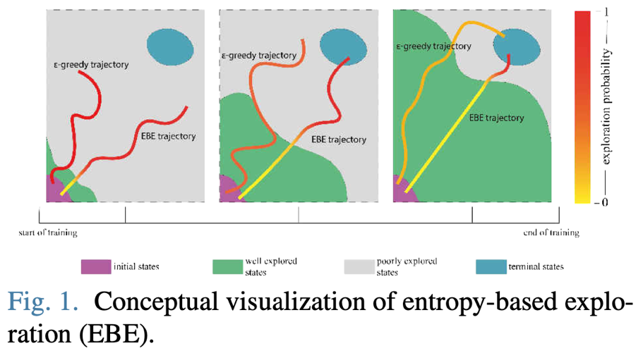
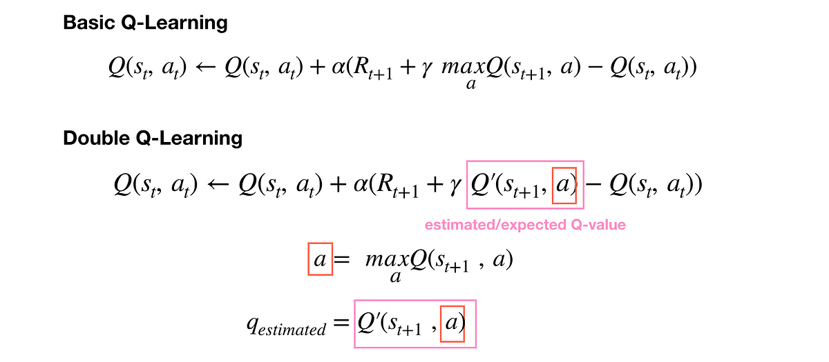
Why DQN?
I find the mathematics of temporal-difference learning to be the most interesting, and DQN is a great way to implement that with a rapidly simulatable game like mine.
The algorithm I’m actually implementing is Double Q-Learning, or DDQN.

Slide 3

Quick Explanation of TD Learning
The best explanation I can give to start off visualizing how temporal-difference learning works, though absolutely nowhere near perfectly accurate, is to imagine using a metal detector.
The metal detector is useless on its own, and so are you with no ability to detect metal, only walk
Take your position with a given level of beeping and look at all possible next states and choose the highest beeping state.
Build in this behavior naturally by learning to walk in certain trajectories that naturally follow a high reward path.

Slide 4
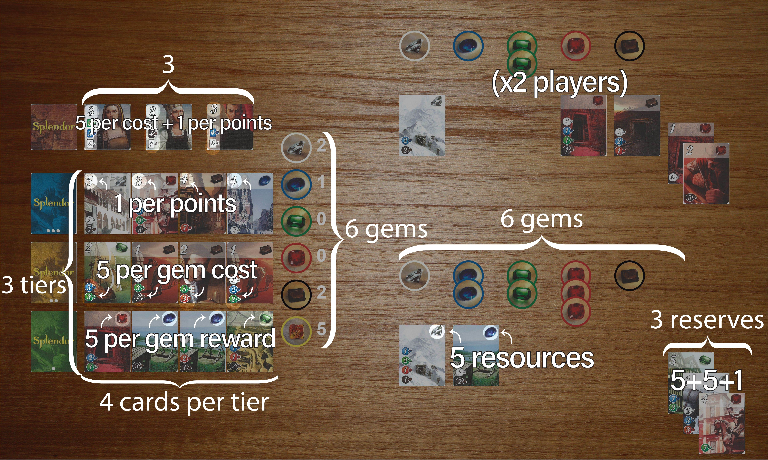
A lot of people worry about excessively large state spaces in reinforcement learning. But what is a large state space? It actually only has to do with the ability of the state transitions to map cleanly onto actions. That is, if I make an action and cause clear change in the state, my q-function can be capable of producing different rewards in each of the states. It’s just down to whether my reward function is good at that point.
In my states, you can see that actions cause distinct changes in the cards available abd gems available etc. Each one of these is something that the model has to learn to deal with and understand.

Slide 5
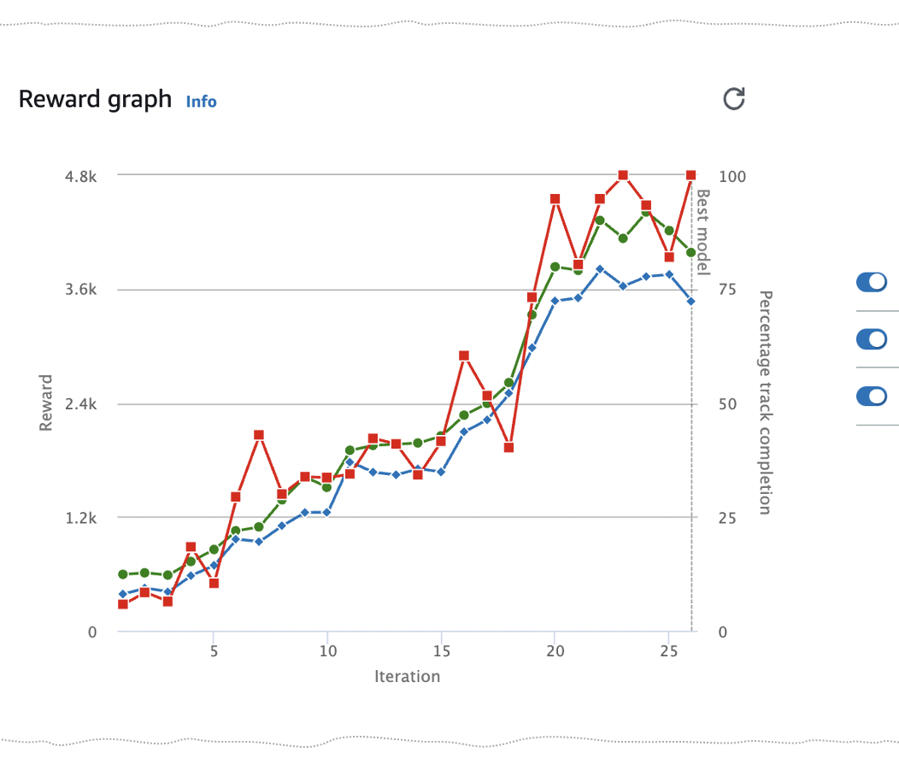
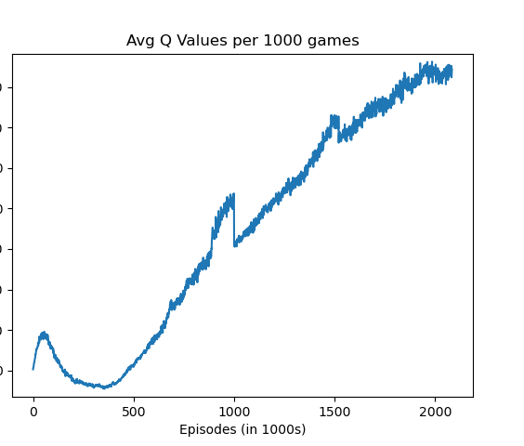
This shows the reward that the model actually got averaged over the whole game (winning gives reward, and so does buying good cards). Note how they correlate.
Actual reward
Model’s estimation of value

Slide 6
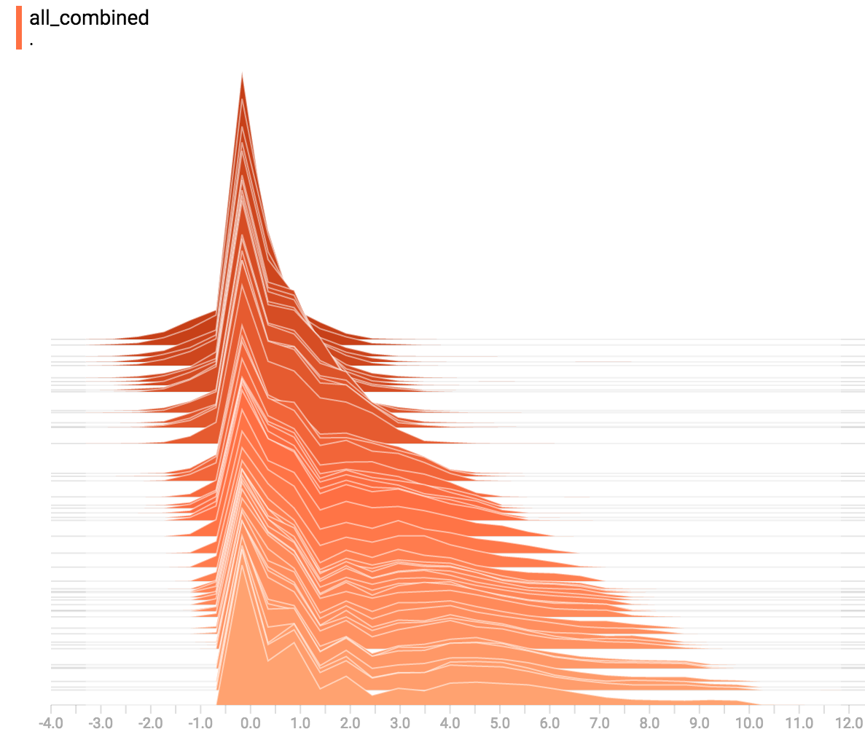
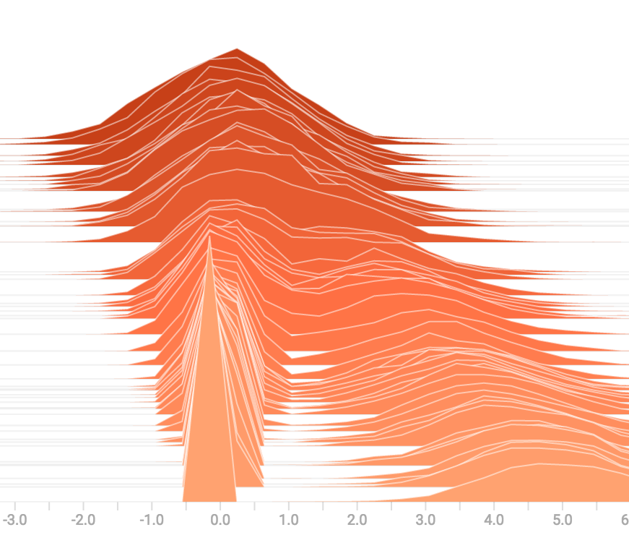
Visualization of the model. Early epochs are at the back. The model slowly adjusts its weight distribution over time.
Dense Layer
Final Action Layer

Slide 7
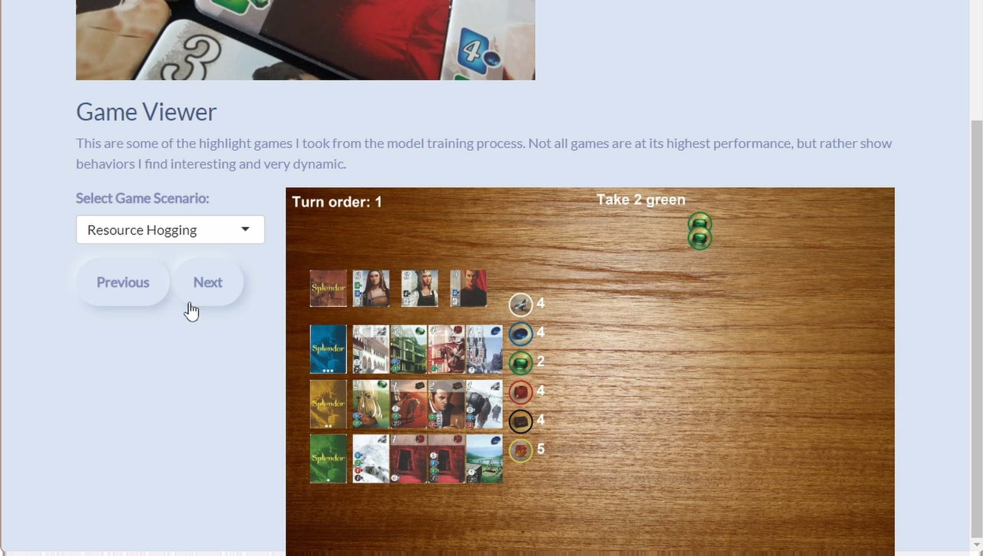
And, the model works! You can select from whatever interesting games I found during training, and move forward/backward through them!
(Video)

Slide 8

Thank You!

